Slide 1
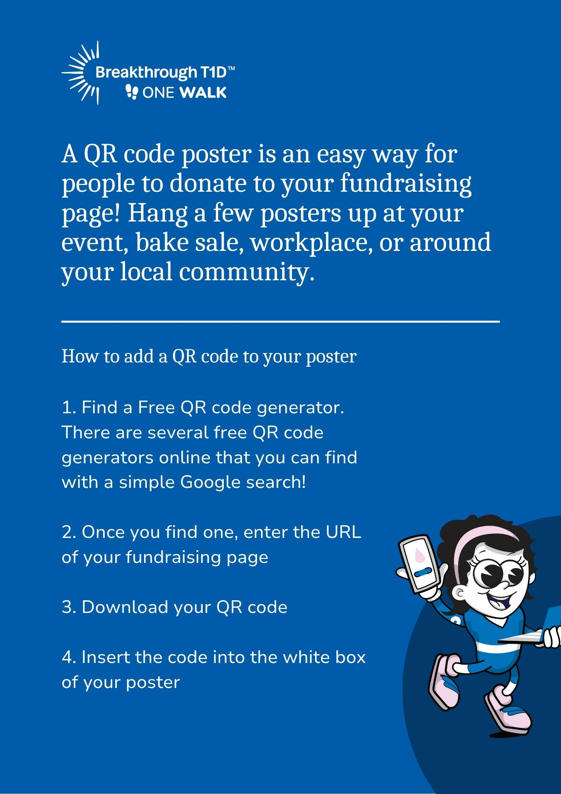

Slide 2
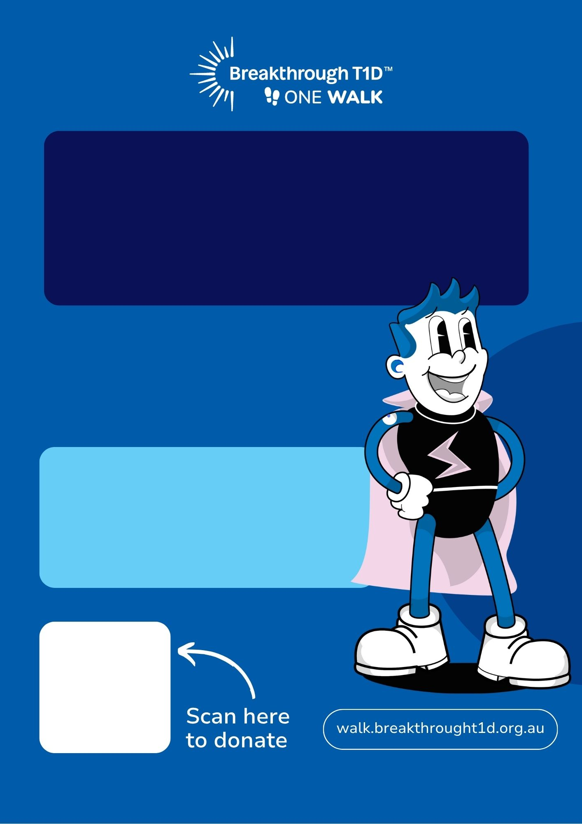
[insert your name] is fundraising to help create a world without type 1 diabetes.
My goal is to raise $[goal here]
Funds raised will go towards supporting breakthrough research aimed at finding cures and improving lives.

Slide 3
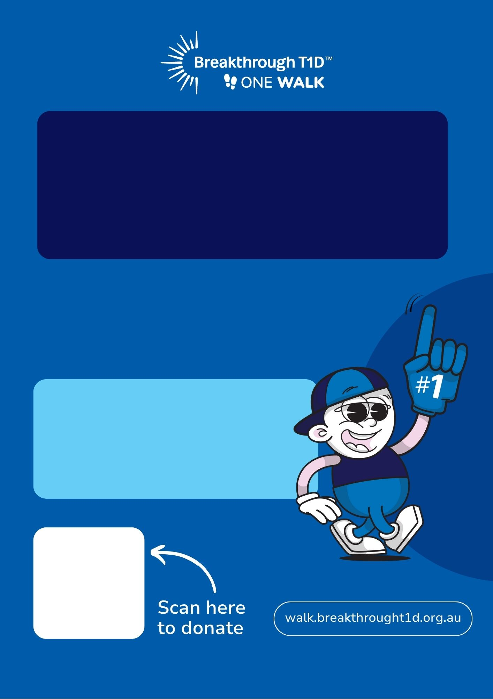
[insert your name] is fundraising for [insert name of special person you are fundraising for e.g. my son Ben,] who lives with type 1 diabetes.
My goal is to raise $[goal here]
Funds raised will go towards supporting breakthrough research aimed at finding cures and improving lives.

Slide 4

[insert your name] is fundraising for [insert name of special person you are fundraising for e.g. my son Ben,] who lives with type 1 diabetes.
My goal is to raise $[goal here]
Add image to the space here
Funds raised will go towards supporting breakthrough research aimed at finding cures and improving lives.

Slide 5
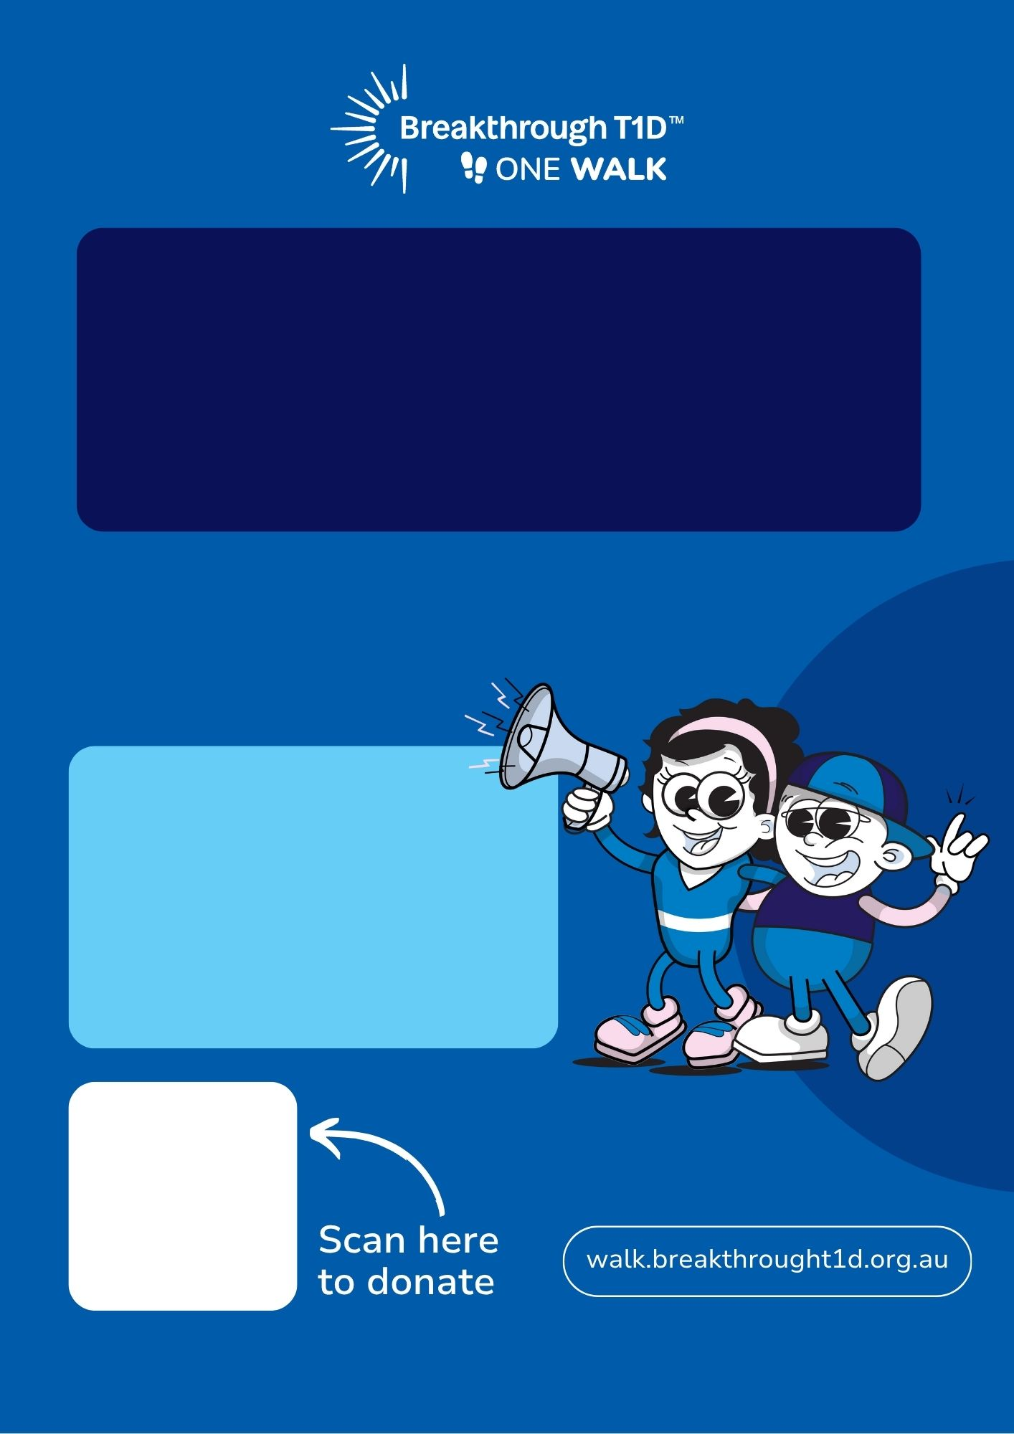
Team [insert your team name] are fundraising to help create a world without type diabetes.
Our goal is to raise $[goal here]
Funds raised will go towards supporting breakthrough research aimed at finding cures and improving lives.

